Slide 1
Project Proposal January 30, 2015 By: LORT Studios (formally known as team Camel)
Group members: Xiang Bao, Gurmeet Dhillon, Sasha Babicki, and Justin Wong

Slide 2
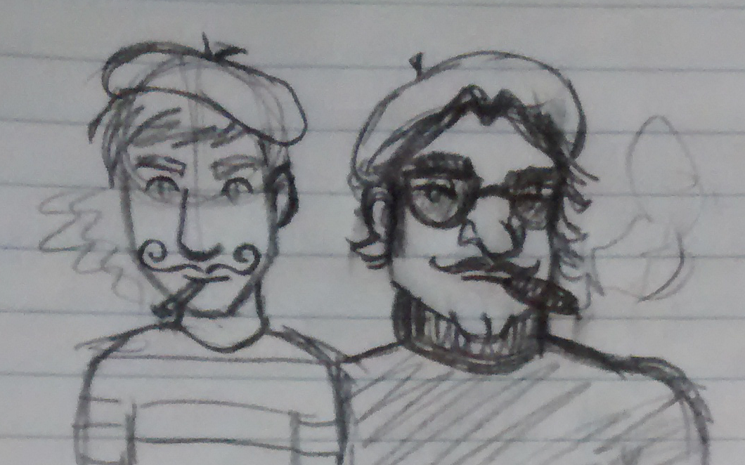
“Le Chase”
Le Chase is a story about … [SUMMARY]

Slide 3
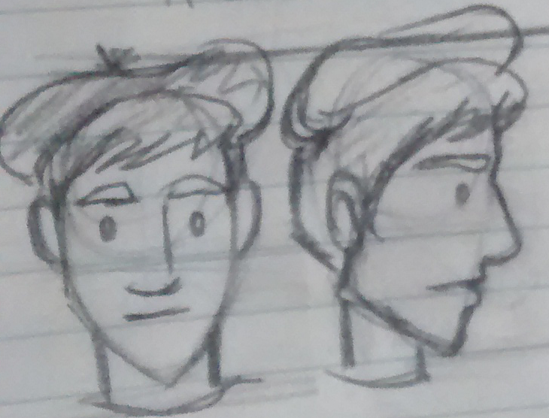
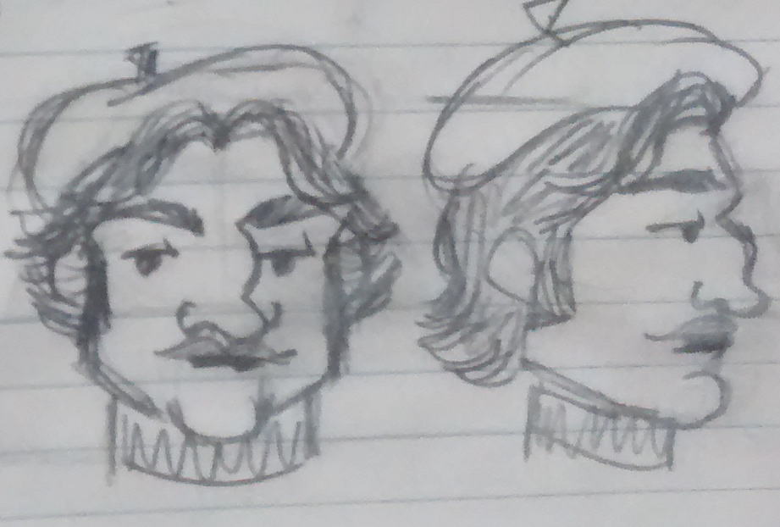
The Main Characters
Pierre – the good guy:
Jacques – the bad guy:

Slide 4
Other Characters
American tourist and his family
The boat rider
Old woman

Slide 5
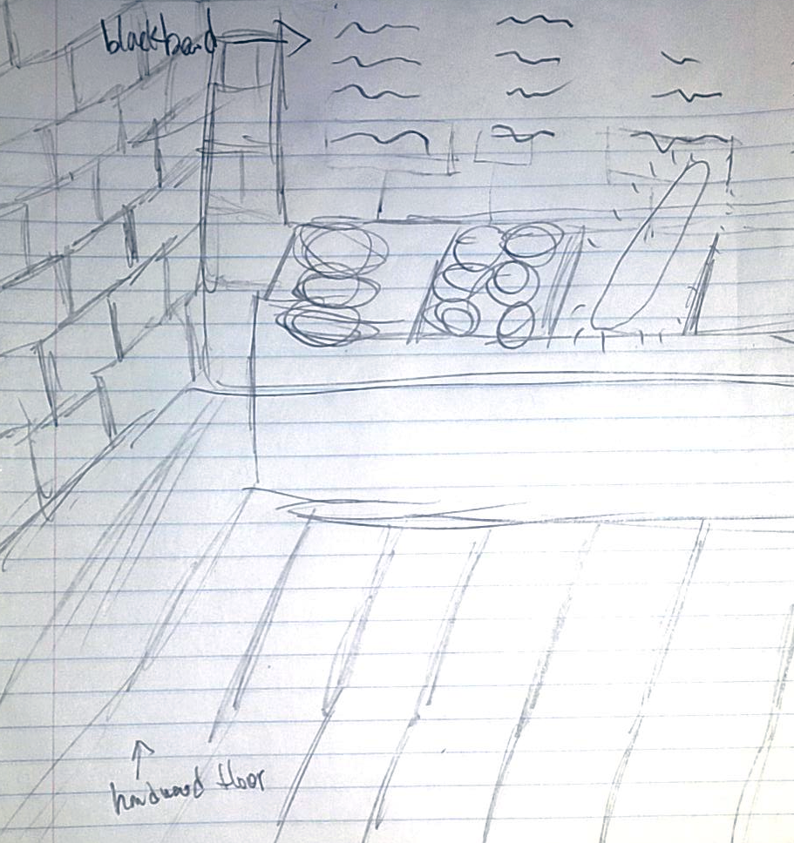
Storyboard: Scene 1
A title sequence and message is displayed on the screen that says "This film has been translated to English for your viewing pleasure" in broken English. Two men are standing in a bakery looking at a basket with only one baguette in it. They look at each other and back at the baguette. They each grab the baguette at the same time, there is a stand-off with western music playing. Pierre points to something behind Jacques, while Jacques is distracted Pierre runs off with the baguette.

Slide 6
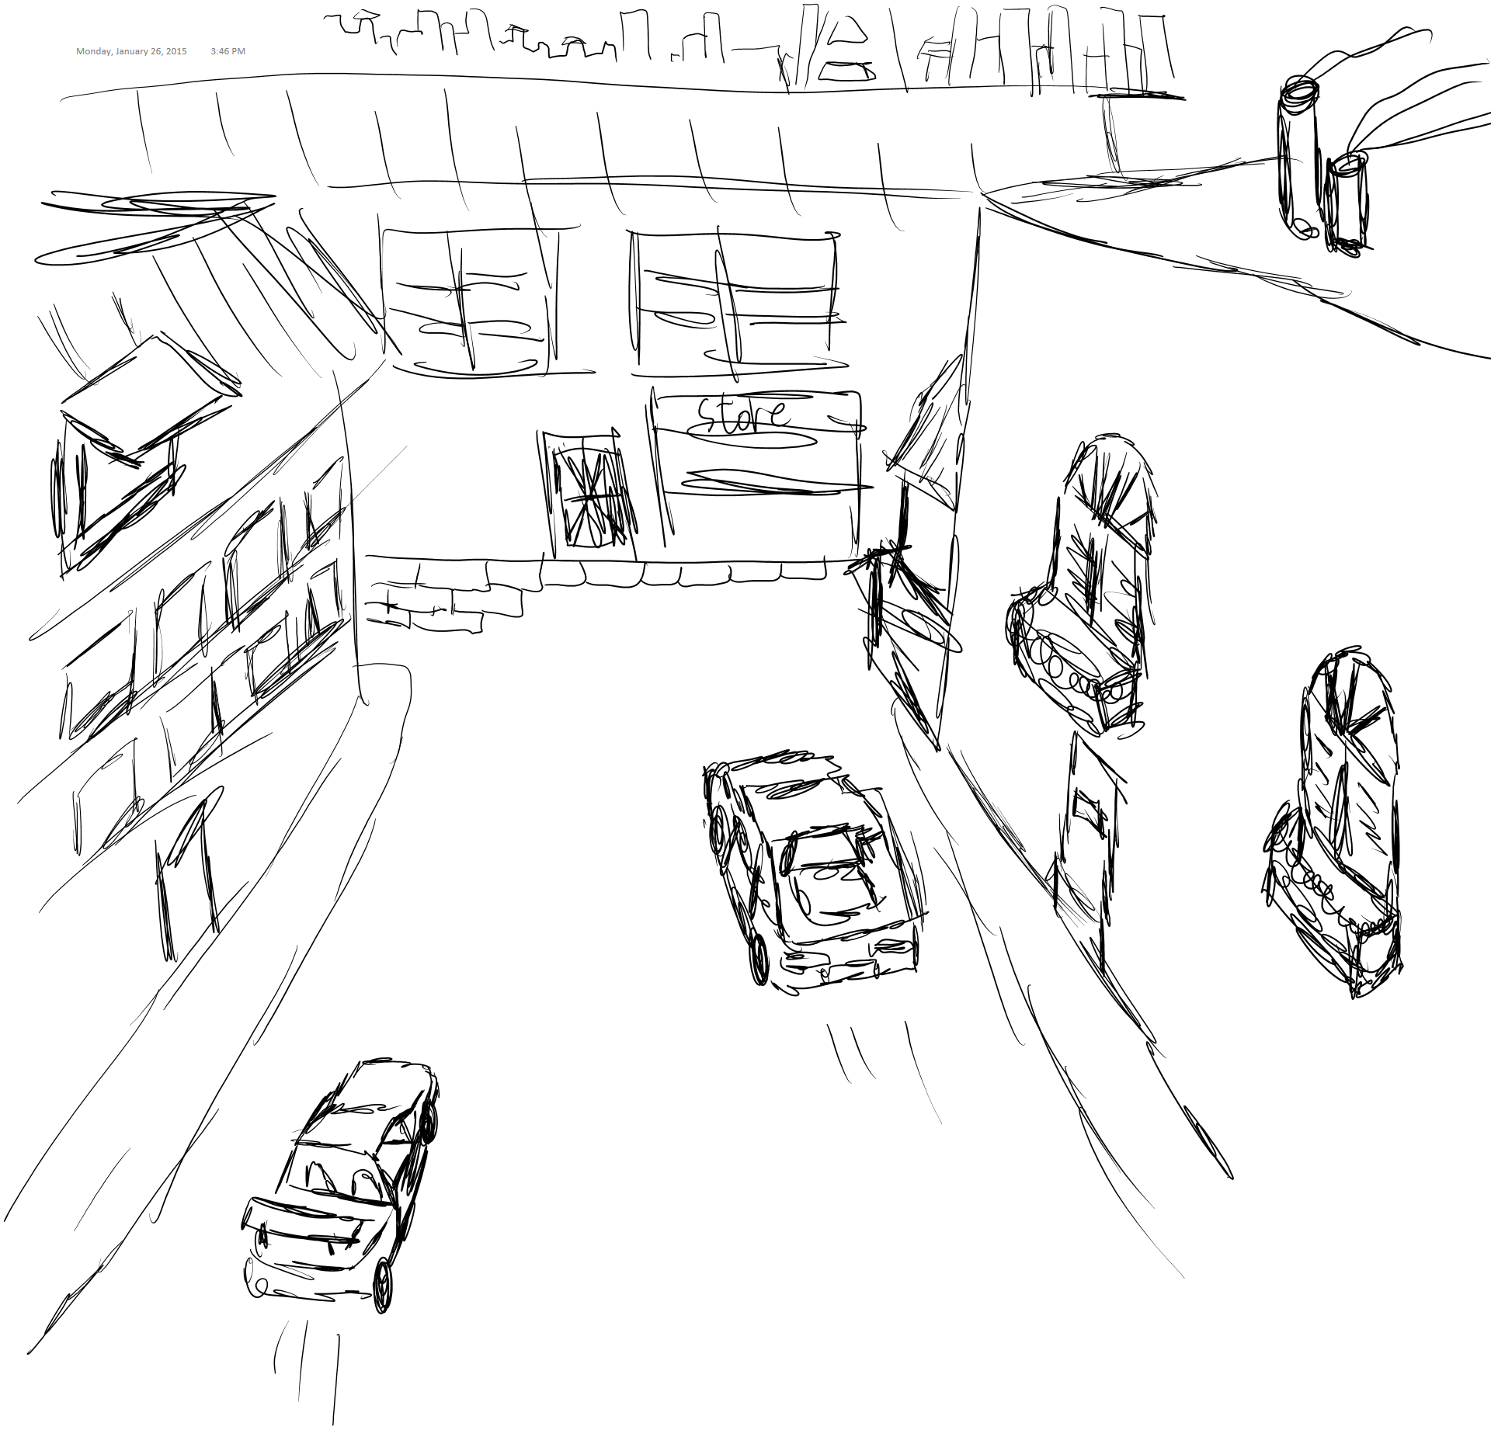
Storyboard: Scene 2
Pierre runs to his car as Jacques chases him. They each get into their cars and drive away. There is a high speed pursuit, with 2 sharp turns and then they are on the freeway.

Slide 7
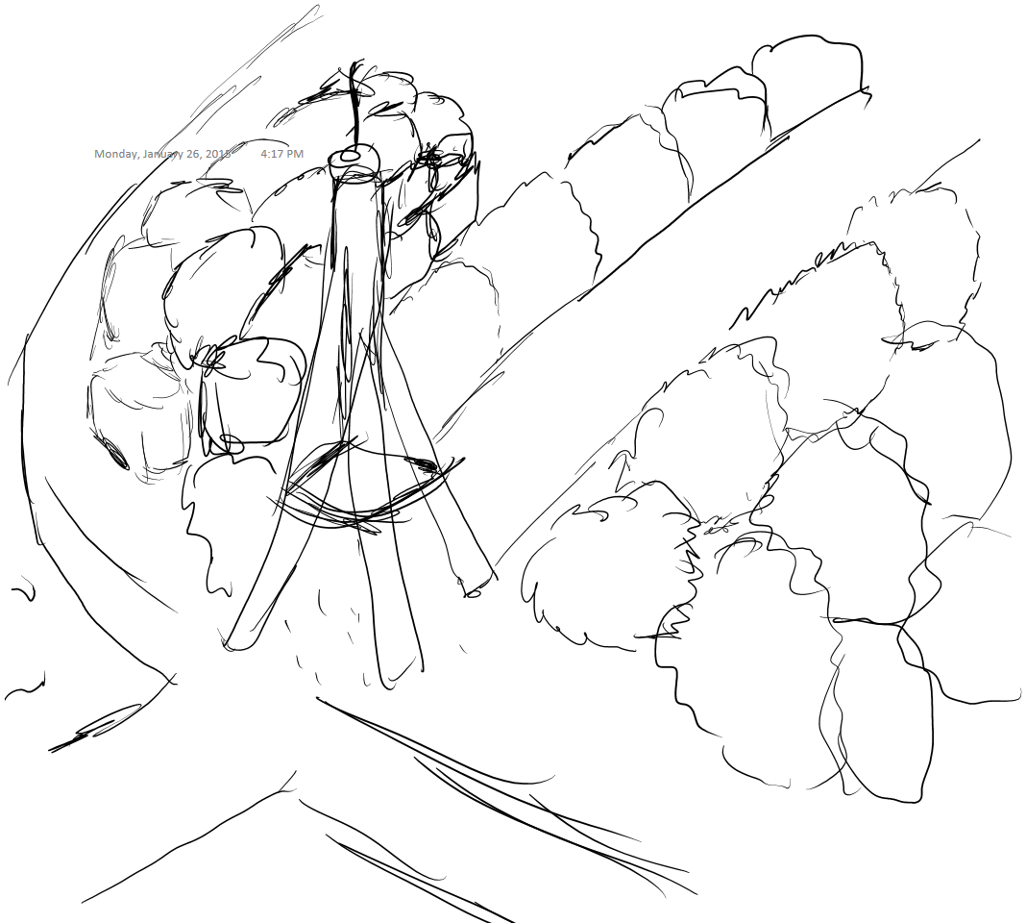
Storyboard: Scene 3
After the chase scene on the freeway the men in their cars reach the Arc de triomphe. In slow motion they fly off a ramp and end up flipped up side down in mid air under the arc, make eye contact with each other in the air, and land right side up. They continue driving on the road towards the Louvre. They drive straight off the road towards the Louvre. The shot changes to focus on an American tourist taking a photo of his family in front of the Louvre Pyramid, with calm music in the background. All of a sudden the cars drive between the American and his family, right as the photo is taken.

Slide 8
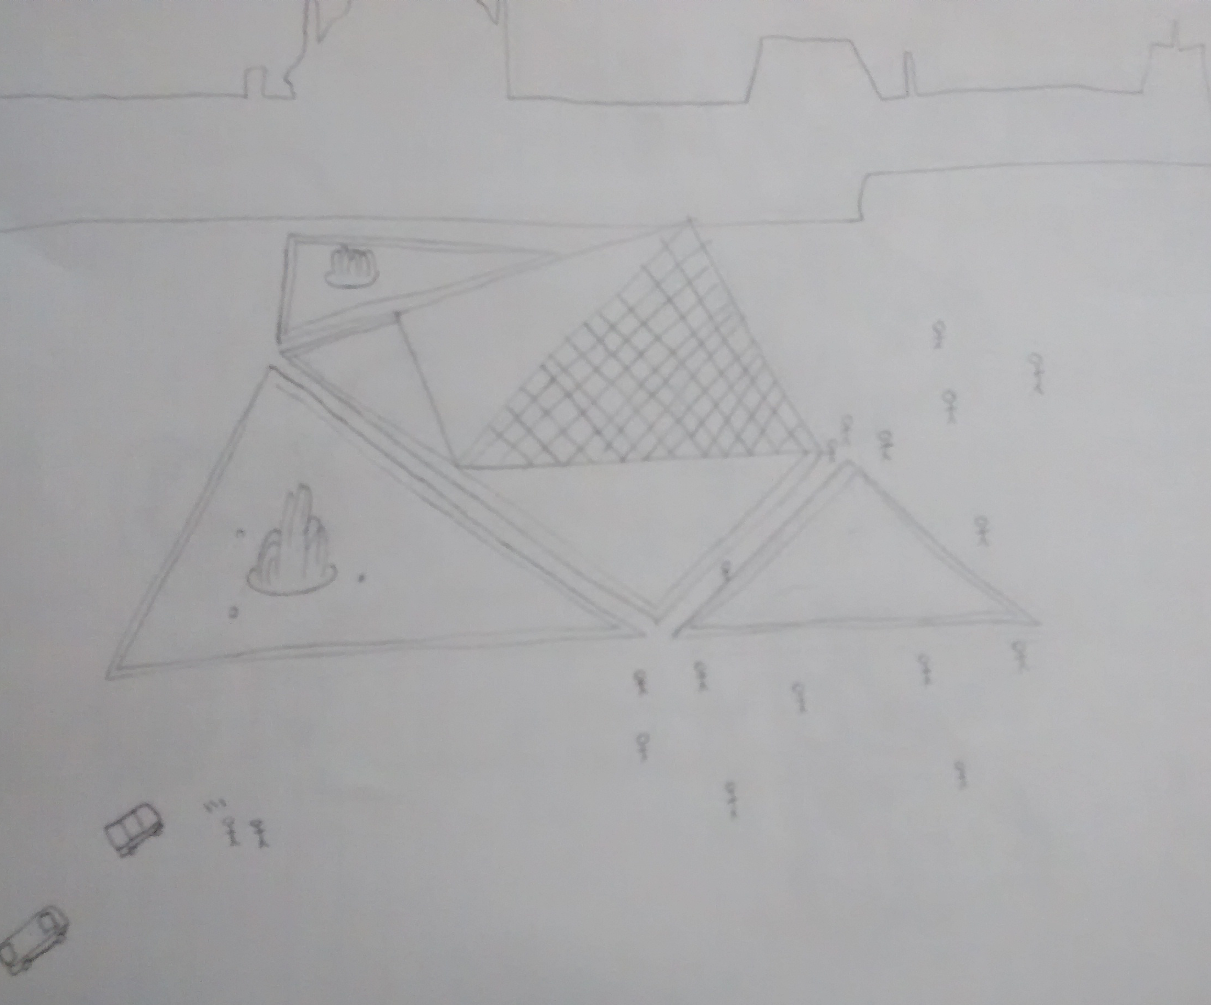
Storyboard: Scene 4
Areal shot of the cars racing by the river. Camera pans to see the cars racing from the perspective of a boat driver on the river. Establishing shot of the Eiffel Tower with lots of people around. The cars drive through and people move our of the way.

Slide 9
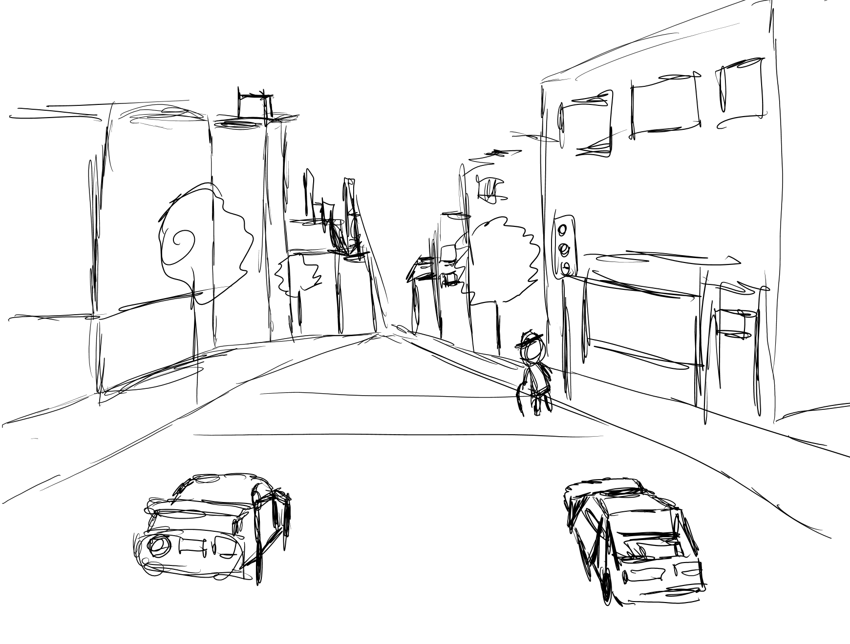
Storyboard: Scene 5
The cars arrive at an intersection and a little old lady tries to cross the road at the cross walk. The cars screech to a halt. Pierre gets out of his car to help the old woman cross the street. At the same time Jacques breaks into Pierre's car to steal the baguette. Pierre looks back at Jacques stealing his car and shakes his head in disgust.

Slide 10
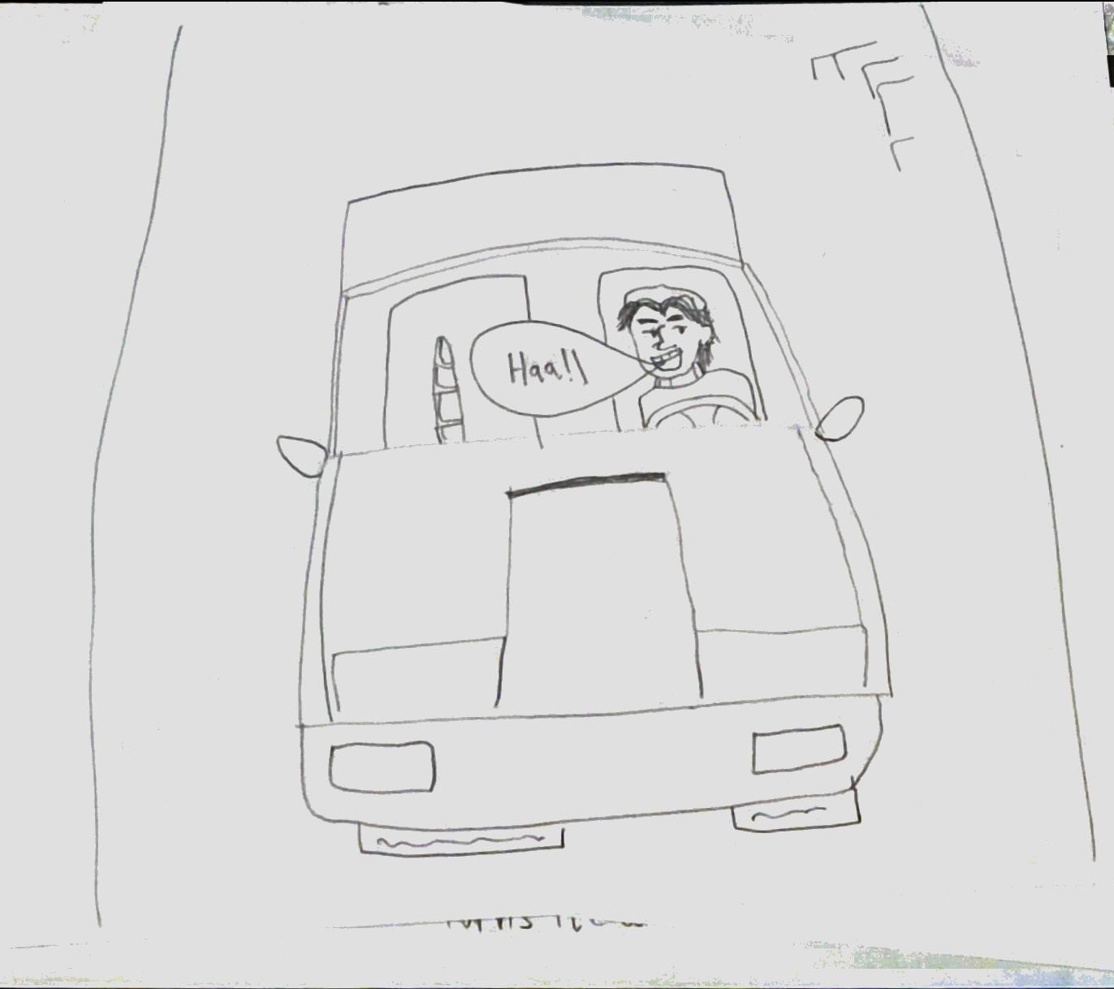
Storyboard: Scene 6
Jacques drives off with Pierre's car. Jacques looks behind him as he is driving with a smug look on his face, then turns back to face the road in front of him and drives into a wall. The view from Jacques’ perspective turns to black as he crashes into the wall and screeching/crash noise are heard.

Slide 11
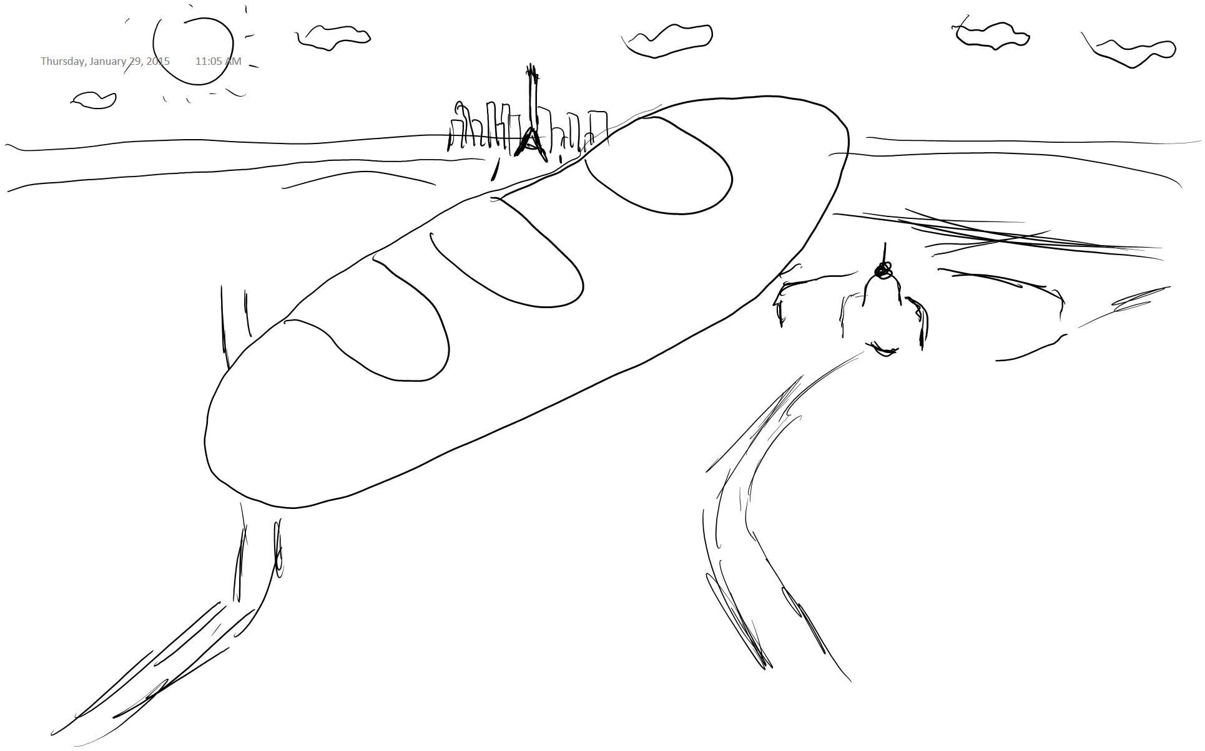
Storyboard: Scene 7
Back at the crosswalk Pierre turns to look towards the source of the noise. The baguette is shown flying through the air. The baguette falls from the sky into Pierre's hands. Pierre breaks the baguette in half and shares it with the old lady. The credits roll.

Slide 12
Project Planning
We have meetings every Monday at 3pm, and Friday at 3pm when needed.
We use github for version control.
We use the eclass group forum and meetings to communicate.

Slide 13
Task Allocation
 | Sam | Gary | Sasha | Justin
1st coordinator | ✓
2nd coordinator | ✓
3rd coordinator | ✓
4th coordinator | ✓
Story/message creation |  |  | ✓
Storyboard artwork & scene creation | ✓
Proposal write-up |  |  | ✓
Modeling & texture | ✓ | ✓ | ✓ | ✓
Animation | ✓ | ✓ | ✓ | ✓
Special effects | ✓ | ✓ |  | ✓
Rendering | ✓ |  |  | ✓
Final video & audio | ✓ | ✓ | ✓ | ✓
Final report write-up |  | ✓ | ✓ | ✓

Slide 14
Time Allocation
 | Feb 2 | Feb 9 | Feb 16 | Feb 23 | Mar 2 | Mar 9 | Mar 16 | Mar 23 | Mar 30
 | Wk5 | Wk6 | Wk7 | Wk8 | Wk9 | Wk10 | Wk11 | Wk12 | Wk13
Sasha | 10 | 10 | 10 | 10 | 10 | 10 | 10 | 10 | 10
Sam | As required | As required | As required | As required | As required | As required | As required | As required | As required
Gary | 8 | 8 | 8 | 8 | 8 | 8 | 8 | 8 | 8
Justin | When needed | When needed | When needed | When needed | When needed | When needed | When needed | When needed | When needed

